Slide 1
How do Satellites Help us Understand More About Climate Change and the Earth
By all members of robot club in All Saints School 2017

Slide 2
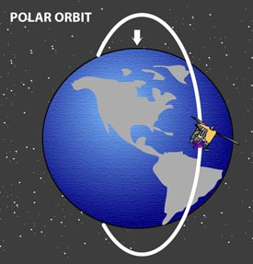
Polar Satellites
It circles the planet in a north-south direction as Earth spins beneath it in an east-west direction.
It is 350,900km away from Earth.
Polar Orbits allow satellites to scan the whole surface of the Earth.
Remote sensing satellites, weather satellites, and government satellites are nearly always in polar orbit because of the coverage.
All polar orbiting satellites meet at The North Pole.
When one Polar orbit satellite is over America, another Polar Satellite is flying over the North Pole.

Slide 3
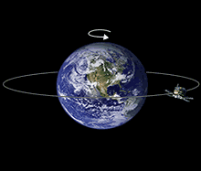
Geostationary Satellite
It orbits directly over the equator orbiting from west to east.
It goes the same speed as the Earth does.
It stays around the equator.
It tracks Weather.
There are lots of them.
It looks at the same place all the time.
It orbits at an altitude of 35,800km (22,300 miles)

Slide 4
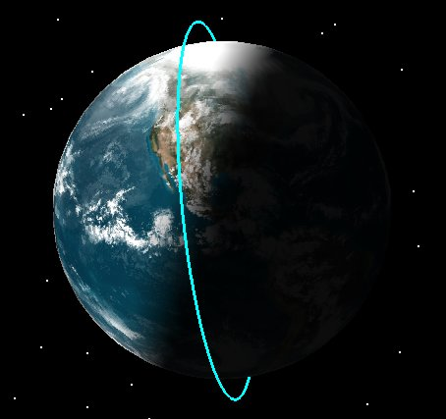
Sun-Synchronous Satellite
Passes the same point of the Earth at the same local time.
Follows the same path as the Polar Satellite.
Earth observation satellites follow the sun synchronous orbits most of the time.
The satellite travels from the north to the south pole.
There is a special kind of sun-synchronous orbit called a dawn-to-dusk orbit.In a dawn-to-dusk orbit, the satellite trails the Earth's shadow.

Slide 5
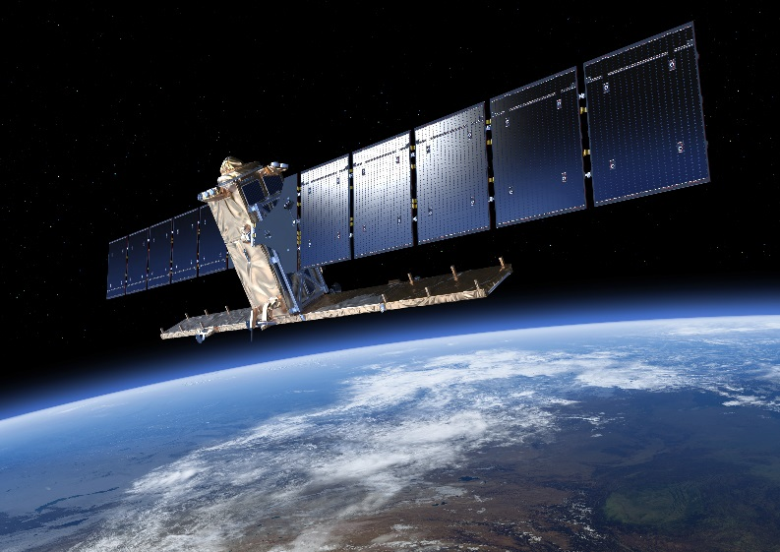
Sentinel 1
Sentinel 1 is a Satellite which got launched April 3rd 2014.
It’s power is 5.9kW.
It’s launch mass I 2,300 kg.
It’s start date was the same as when it got launched. (April 3rd 2014)
It’s first launch of Sentinel-1A;
It launched twice.

Slide 6
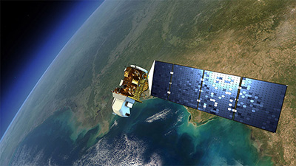
Landsat 8
It’s launch date is 11 February 2013.
It’s Period is 1.6 hours.
It’s reference system is Geocentric orbit.
It’s Launch site is Vandenberg Air Force base, Vandenberg AFB Space Launch Complex 3.

Slide 7

The End!!!

